Slide 1

DEPARTMENT OF COMPUTER SCIENCE AND ENGINEERING
Professional Training - 1
HOSPITAL BED UTILIZATION & PATIENT FLOW ANALYSIS
PROJECT STUDENT GUIDE
G ALEKYA, 42110063 Dr. M. Nafees Muneera, M.E., Ph.D., Associate Professor, CSE

Slide 2
AGENDA
Certificate
Introduction
Abstract
Objective
System Architecture / Ideation Map
Module Implementation
Results and Discussions
Conclusion
References

Slide 3
COURSE CERTIFICATE

Slide 4
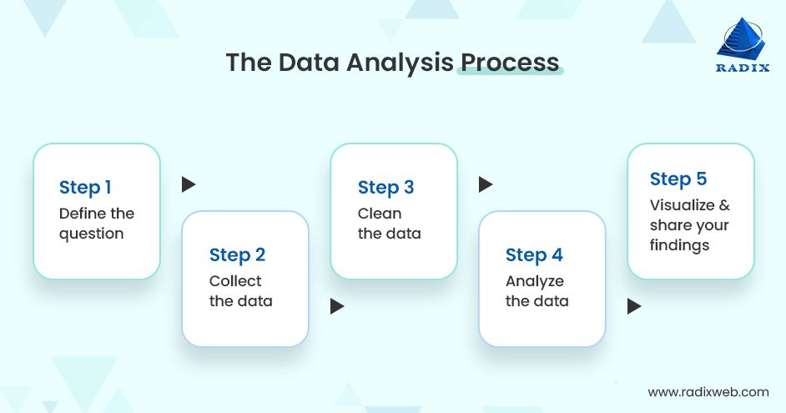
INTRODUCTION
WHAT IS DATA ANALYTICS & DATA VISUALIZATION ?
Data Analytics refers to the process of examining, cleaning, transforming, and modelling data
It is used to discover useful information, inform conclusions, and support decision-making.
Data analytics can be descriptive, predictive, or prescriptive depending on the type of analysis

Slide 5

INTRODUCTION
Data Visualization is the graphical representation of data.
It helps in understanding complex data by presenting it in a visual context.

Slide 6
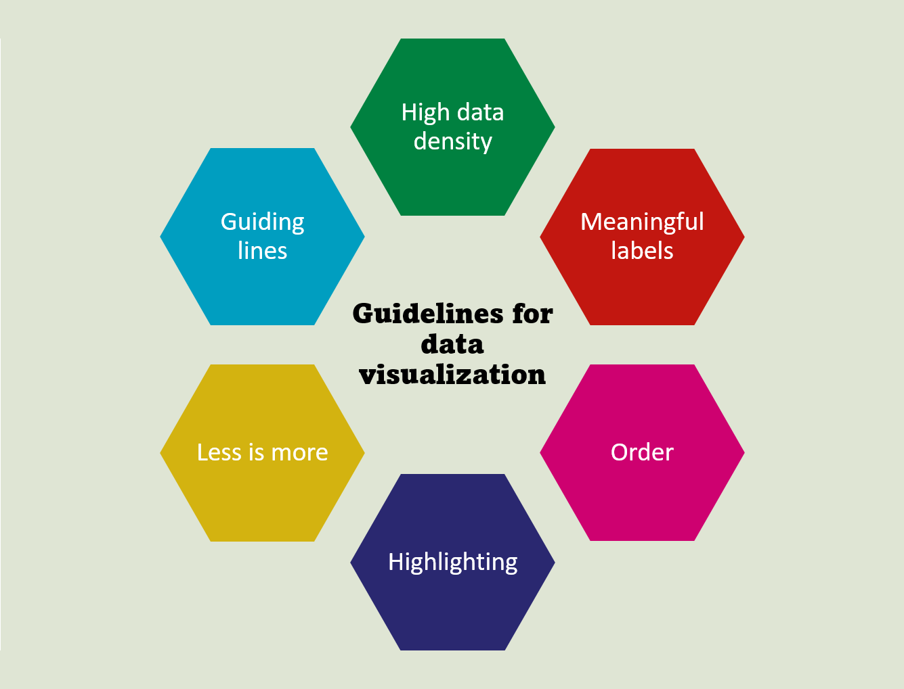
INTRODUCTION

Slide 7
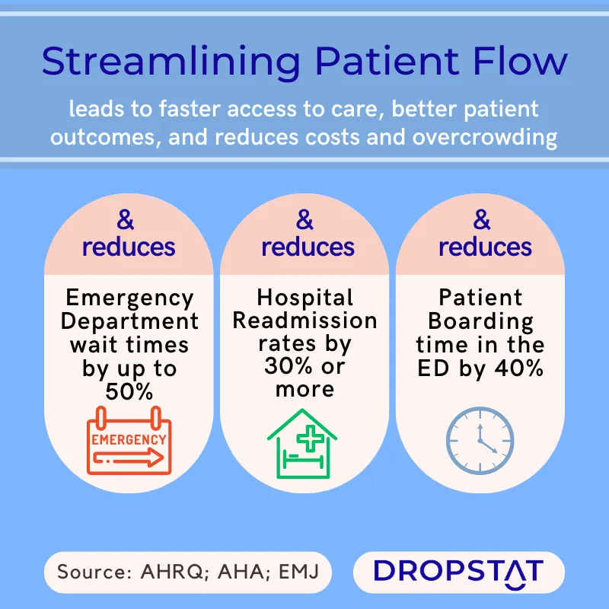
INTRODUCTION
Hospital bed utilization and patient flow analysis are critical components of healthcare management that significantly impact the quality of patient care and operational efficiency.
Bed utilization refers to the percentage of available beds that are occupied by patients at any given time.
Patient flow analysis examines how patients move through the healthcare system, from admission to discharge.
Monitoring these rates helps hospitals make informed decisions about staffing, resource allocation, and expansion needs.

Slide 8
ABSTRACT
This project analyses hospital bed utilization and patient flow to improve healthcare efficiency using a dataset of 50 patient records. Key metrics include patient demographics, reasons for admission, treatment costs, and hospital capacity indicators. The study identifies trends in medical conditions, from acute incidents like chest pain to chronic issues like diabetes, while also examining the role of insurance coverage and potential disparities in healthcare access. By evaluating metrics such as bed occupancy, admissions, and average length of stay, the project aims to inform healthcare management practices, optimize resource allocation, and improve patient care. The analysis also explores discharge conditions and operational bottlenecks to identify areas for improvement in patient flow management. These insights can help healthcare administrators address inefficiencies, enhance resource utilization, and streamline care delivery.

Slide 9
OBJECTIVE
1. Evaluate Bed Utilization Rates:
Analyze historical and real-time data to assess the occupancy rates of hospital beds, identifying trends and patterns that indicate how effectively resources are utilized.
2. Analyze Patient Flow:
Map the patient journey from admission to discharge, identifying key stages in the process and analyzing factors that contribute to delays or inefficiencies.
3. Optimize Resource Allocation:
Provide actionable insights for hospital management to optimize bed utilization and allocate resources more efficiently, ultimately improving overall operational effectiveness.

Slide 10
OBJECTIVE
4. Enhance Data Visualization:
Utilize advanced visualization tools to transform complex data into intuitive dashboards and reports, making insights easily accessible and actionable for stakeholders.
5. Support Data-Driven Decision Making:
Empower hospital administrators and clinical staff with data-driven insights to inform strategic decisions that enhance patient care and operational efficiency.

Slide 11
LITERATURE SURVEY
YEAR | AUTHOR (s) | TITLE | IMPLEMENTATION
2021 | Bennett, A., & Hargrove, S. | “Using visualization tools to enhance hospital bed utilization analysis" | Utilized software tools (e.g., Tableau) to analyze historical and real-time bed occupancy data. Conducted case studies in multiple hospitals to evaluate the effectiveness of visualization.
2022 | Kumar, S., & Singh, R. | "Application of data visualization techniques in hospital management" | Employed techniques such as dashboards and heat maps to visualize patient flow and resource allocation. Conducted workshops to train hospital staff on these tools.

Slide 12
LITERATURE SURVEY
YEAR | AUTHOR (s) | TITLE | IMPLEMENTATION
2022 | Li, Y., & Zhang, J. | "Dynamic visualization of patient flow in hospital settings" | Developed a web-based platform for dynamic visualization, allowing real-time tracking of patient movements. Integrated data from EHRs and other hospital systems for comprehensive insights.
2023 | Omar, M., & Patel, A. | "Improving patient flow using data visualization tools" | Implemented data visualization tools to analyze patient journeys through the emergency department, focusing on time spent at each stage.

Slide 13
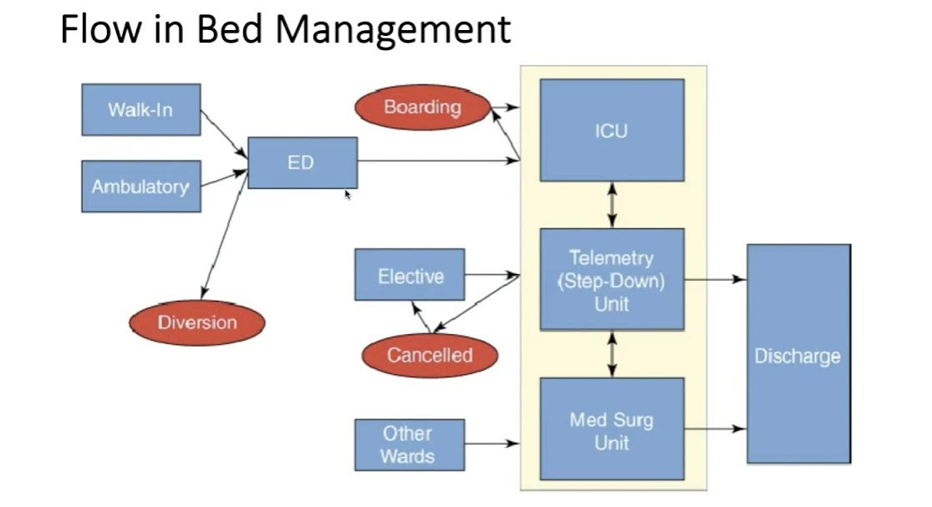
SYSTEM ARCHITECTURE / IDEATION MAP

Slide 14
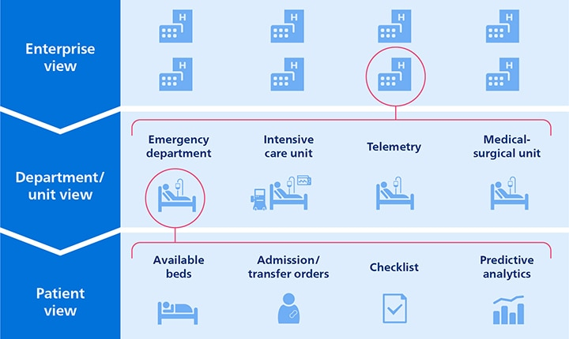
SYSTEM ARCHITECTURE / IDEATION MAP

Slide 15
MODULE IMPLEMENTATION
EXCEL DATA ANALYSIS
Data Preparation and Structuring:
Data Entry: Begin by compiling comprehensive datasets that include patient admission dates, discharge dates, bed occupancy status, patient demographics, and treatment outcomes. Organizing this data into structured tables facilitates easier analysis.
Use of Formulas: Excel’s powerful functions (like VLOOKUP, IF statements, and array formulas) enable complex calculations, such as identifying patients with extended lengths of stay or determining the average number of occupied beds over a specific period.

Slide 16
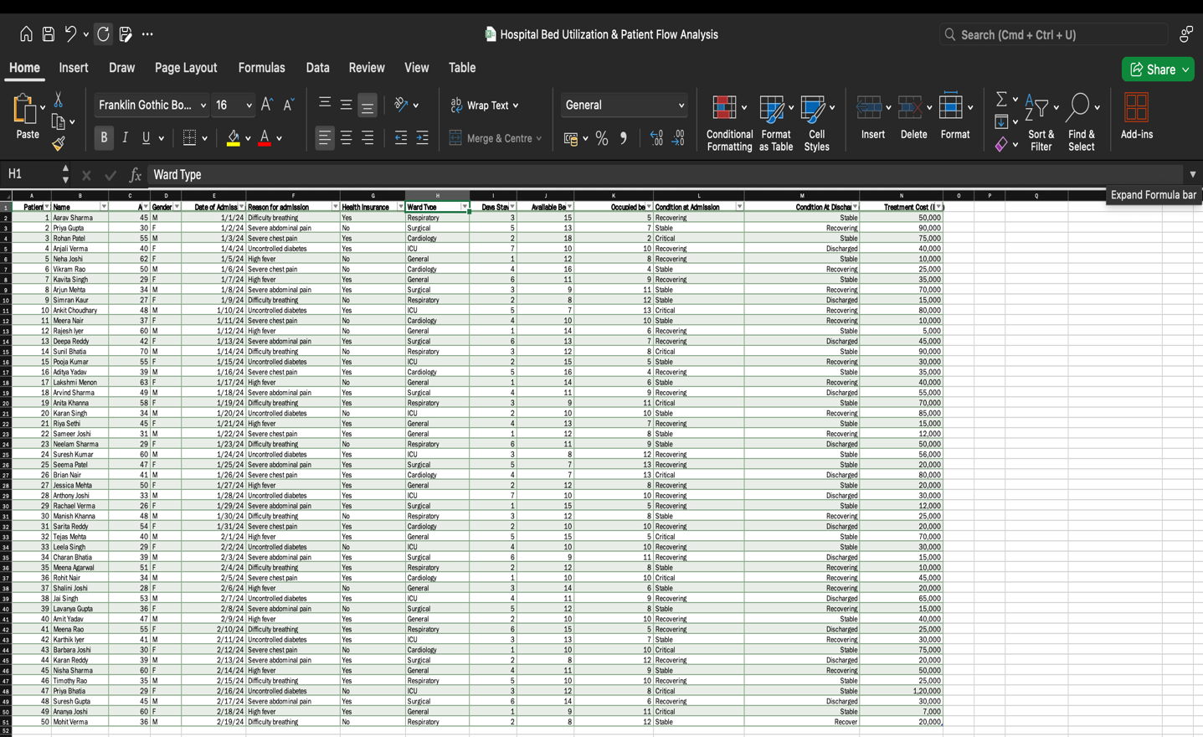
MODULE IMPLEMENTATION

Slide 17
MODULE IMPLEMENTATION
TABLEAU DATA VISUALIZATION
Data Connection and Integration:
Connecting to Data Sources: Tableau can connect to various data sources, including Excel files, SQL databases, and cloud services, enabling seamless integration and real-time updates.
Data Preparation in Tableau: Utilize Tableau Prep for data cleaning and preparation, ensuring that the data is ready for analysis without redundancy or errors.

Slide 18
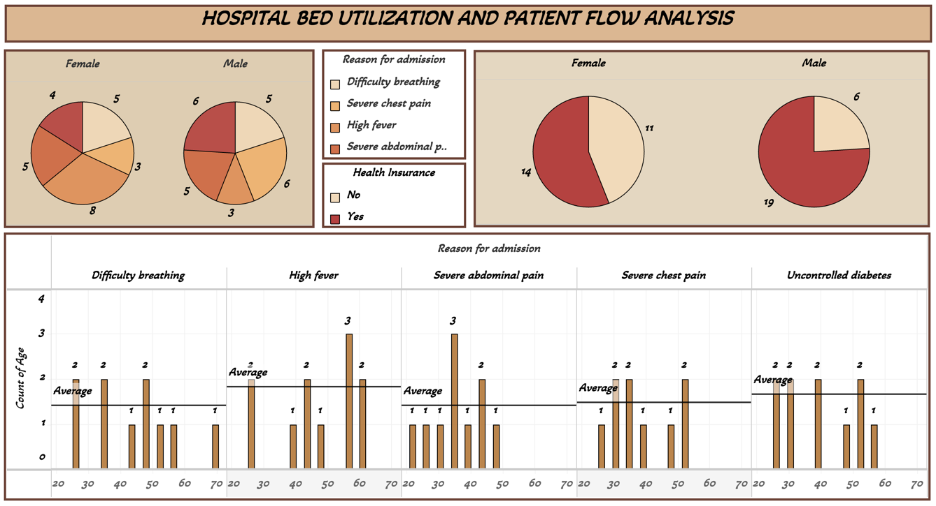
MODULE IMPLEMENTATION

Slide 19
MODULE IMPLEMENTATION
POWERBI REPORTING
DAX for Advanced Calculations:
Implementing DAX: Utilize DAX (Data Analysis Expressions) for creating complex calculations that provide deeper insights, such as calculating cumulative bed occupancy over time or analyzing trends in patient flow.
Time Intelligence Functions: Use time-based DAX functions to compare metrics over different periods (e.g., year-over-year changes in occupancy), allowing for robust trend analysis and performance tracking.
Collaboration and Sharing:
Real-Time Sharing: Power BI facilitates easy sharing of reports with stakeholders via the Power BI service. This allows for real-time collaboration, ensuring all team members have access to the latest insights regarding bed utilization and patient flow.

Slide 20
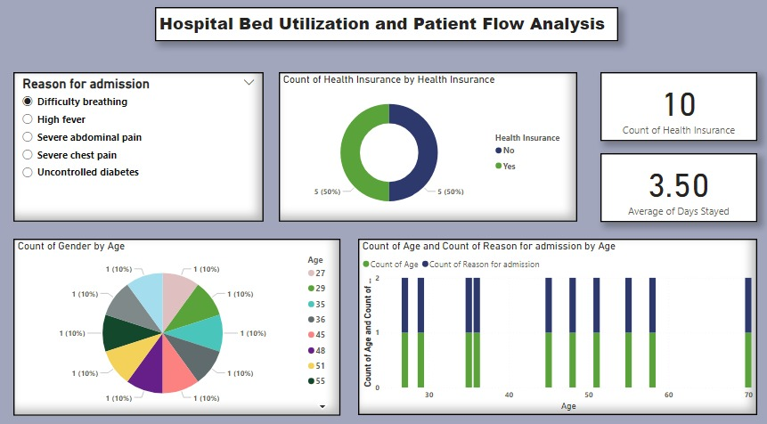
MODULE IMPLEMENTATION

Slide 21
RESULTS AND DISCUSSIONS
CHALLENGES IN HBUPFA
1.⁠ ⁠Variability in Patient Demand
Seasonal Fluctuations: Patient admissions can spike during flu season or due to local outbreaks, making it difficult to predict staffing and resource needs.
Epidemiological Changes: Emerging health trends can affect the volume and types of cases hospitals handle, complicating capacity planning.
2.⁠ ⁠Data Quality and Integration
Inconsistent Data: Inaccurate or incomplete patient data can hinder effective analysis, leading to misinformed decisions.
Siloed Systems: Fragmented information systems across departments can prevent comprehensive analysis and hinder real-time decision-making.

Slide 22
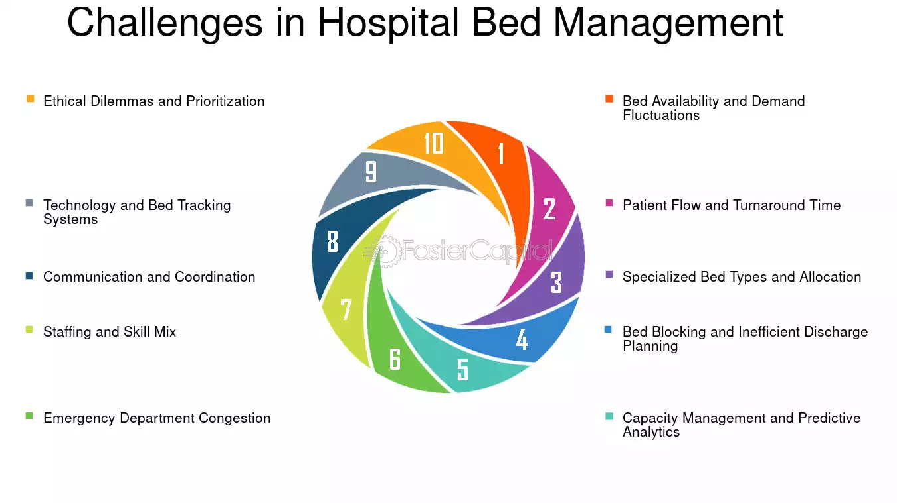
RESULTS AND DISCUSSIONS

Slide 23
RESULTS AND DISCUSSIONS
CHALLENGES IN HBUPFA
3.⁠ ⁠Bottlenecks in Care Processes
Delayed Admissions: Wait times in the emergency department can lead to bottlenecks, affecting patient flow and increasing length of stay.
Inefficient Discharge Processes: Poor discharge planning and communication can result in delayed discharges, tying up beds unnecessarily.
4.⁠ ⁠Interdepartmental Coordination
Communication Gaps: Lack of coordination between departments (e.g., nursing, surgery, pharmacy) can lead to delays and inefficiencies.
Multidisciplinary Challenges: Ensuring that all team members are aligned on patient care plans and discharge processes can be difficult.

Slide 24
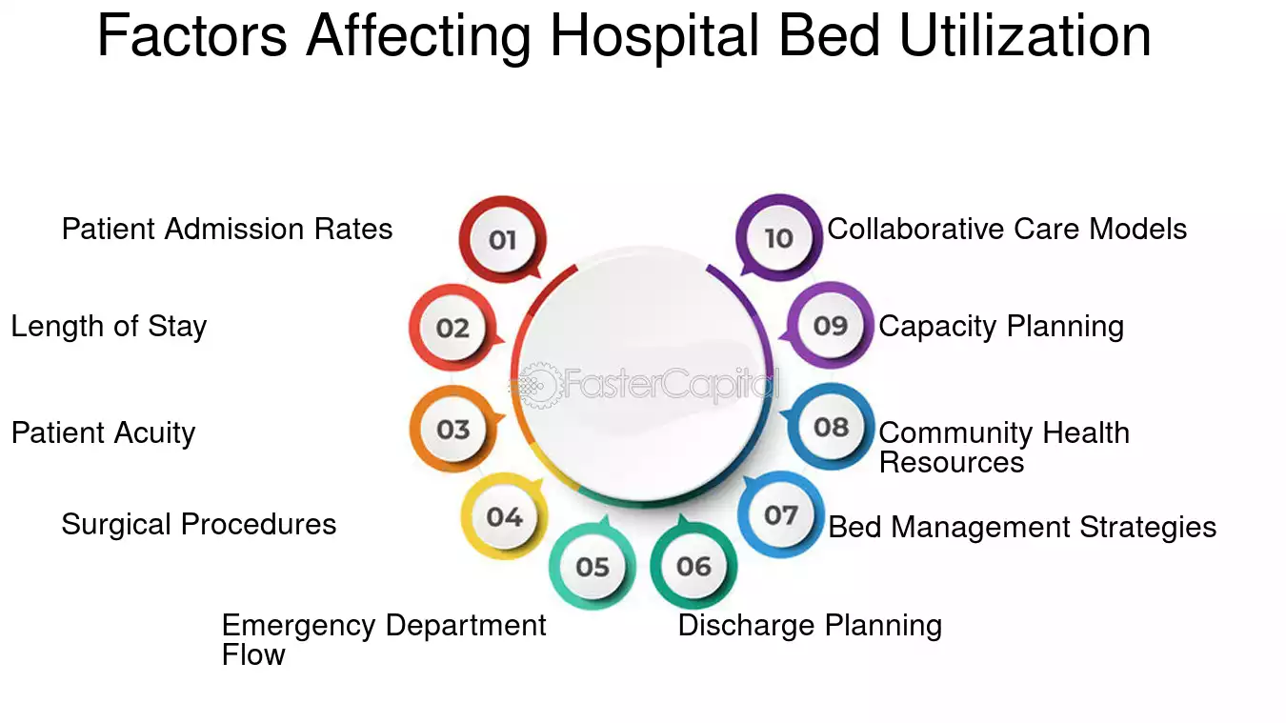
RESULTS AND DISCUSSIONS

Slide 25
RESULTS AND DISCUSSIONS
SOLUTIONS FOR CHALLENGES IN HBUPFA
1.⁠ ⁠Excel Solutions
a. Data Tracking and Analysis
Occupancy Rate Dashboard: Excel can be used to create a dashboard that tracks daily bed occupancy rates, average length of stay, and turnover rates. By using pivot tables and charts, hospitals can visualize trends over time.
Patient Flow Tracking: Excel spreadsheets can track patient admissions, discharges, and transfers. Conditional formatting can highlight bottlenecks or delays, allowing for quick identification of issues.
b. Resource Allocation Models
Capacity Planning Models: Excel can help create models to forecast bed needs based on historical admission data and seasonal trends. This aids in anticipating staffing and resource requirements.

Slide 26
RESULTS AND DISCUSSIONS
SOLUTIONS FOR CHALLENGES IN HBUPFA
2.⁠ ⁠Tableau Solutions
a. Interactive Dashboards
Real-Time Bed Utilization Dashboard: Tableau can create interactive dashboards that display real-time occupancy rates, patient demographics, and flow metrics, enabling quick decision-making.
Patient Journey Visualization: Tableau can visualize the entire patient journey from admission to discharge, highlighting delays and bottlenecks in the process.
b. Predictive Analytics
Trend Analysis: Tableau can analyze historical data to predict future admissions and discharges, helping hospitals to prepare for peak times.
Scenario Modeling: By simulating various scenarios (e.g., increased admissions during flu season), hospitals can assess the impact on bed utilization and resource allocation.

Slide 27
CONCLUSION
In the ever-evolving landscape of healthcare, effective management of hospital bed utilization and patient flow is paramount to ensuring optimal patient care and operational efficiency. This project has illuminated key insights through the robust analysis of data using advanced tools like Excel, Tableau, and Power BI. Our findings reveal not only the critical importance of understanding occupancy trends and patient acuity levels but also the potential for significant improvements through proactive discharge planning and real-time monitoring systems. By harnessing the power of predictive analytics, hospitals can anticipate needs, streamline operations, and ultimately enhance patient experiences. As we navigate the challenges of increasing demand and limited resources, the strategies identified in this analysis provide a clear path forward. Together, we can create a healthcare environment that is not only responsive but also resilient, ready to meet the demands of tomorrow.

Slide 28
REFERENCES
Journals
1. Bennett, A., & Hargrove, S. (2021). "Using visualization tools to enhance hospital bed utilization analysis." Health Information Science and Systems, 9(1), 15-25.
2. Cai, H., & Wang, J. (2020). "Visual analytics for patient flow management in hospitals." Journal of Biomedical Informatics, 109, 103535.
3. Chaudhuri, S., & Ghosh, D. (2019). "A data visualization approach to assess hospital bed occupancy." International Journal of Health Planning and Management, 34(4), 1385-1399.

Slide 29
REFERENCES
Books
1. Goh, T. N. (2020). Data Visualization for Healthcare Management, edited by R. Smith. Springer, pp. 150-170.
2. Kirk, A. (2016). Data Visualisation: A Handbook for Data Driven Design, edited by P. Johnson. Sage Publications, pp. 220-240.
3. Rafferty, J. (2019). Visualizing Patient Flow in Healthcare, edited by M. Anderson. Wiley, pp. 100-130.

Slide 30

THANK YOU
We thank God, Our Department, Guide, Panel Members, Supportive Professors and all Technical and non Technical staff who helped us in our Project.

